Slide 1
Realtime Noise Cancelation Device!
An application based on principles of physics, made possible using computer science!

Slide 2
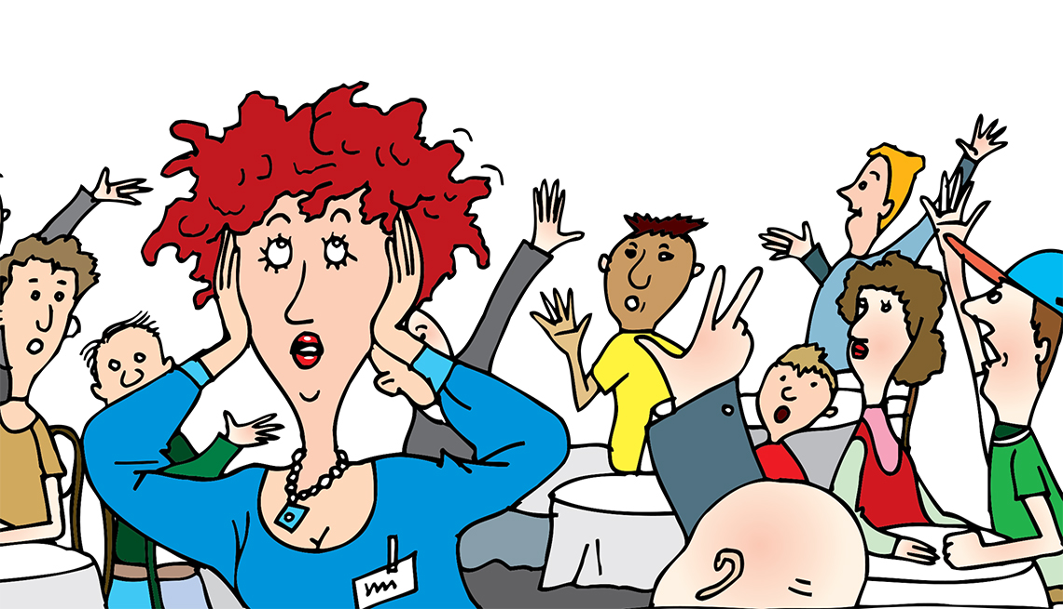
Present Situation
Noise pollution is a pollution emitted by high frequency audio and it is one of the major problems faced by everyone in everyday life. It is the only pollution that directly effects human body. In worse cases, people lose their hearing ability.

Slide 3
Inspiration
Many well known organizations are focusing to make earth a better place for next generation. For example,
Elon Musk is trying his best to make world dependent on solar energy because fossil fuel causes air pollution.
Mr. Beast, a well known YouTuber, and his team is trying their best to plant more and more trees to reduce global warming at some extend.
These fact inspired me a lot to at least try something to improve the world at some extent. That’s why I created this idea!

Slide 4
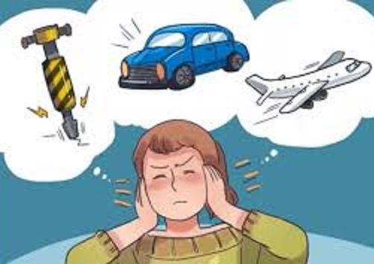
Present Situation
Many NGOs and welfare societies tried to spread awareness to stop it but no body cares. A study shows, the audio frequencies above 60hz is harmful for human ears and normal conversation between two human beings had 50hz of audio frequency. That’s why we need alternatives to prevent ourselves from being a victim of noise pollution before we lose ability to hear!

Slide 5
What are the sources of noise pollution?
Horn from road vehicles
Engine of airplanes
Loud speakers
Listening music at above 70% volume level using earphones

Slide 6
What is Realtime Noise Cancelation Device?
Realtime Noise Cancelation Device is a raspberry pi based mini computer that detects noise using machine learning, and cancel it out to provide a noise free environment at a certain distance.

Slide 7
What will it contain?
Raspberry Pi
Some microphones
Speakers/Buzzers
Battery
3D Modelled Case
A cloud database
A mobile app that registers user voice to make sure it won’t cancel it out mistakenly.

Slide 8
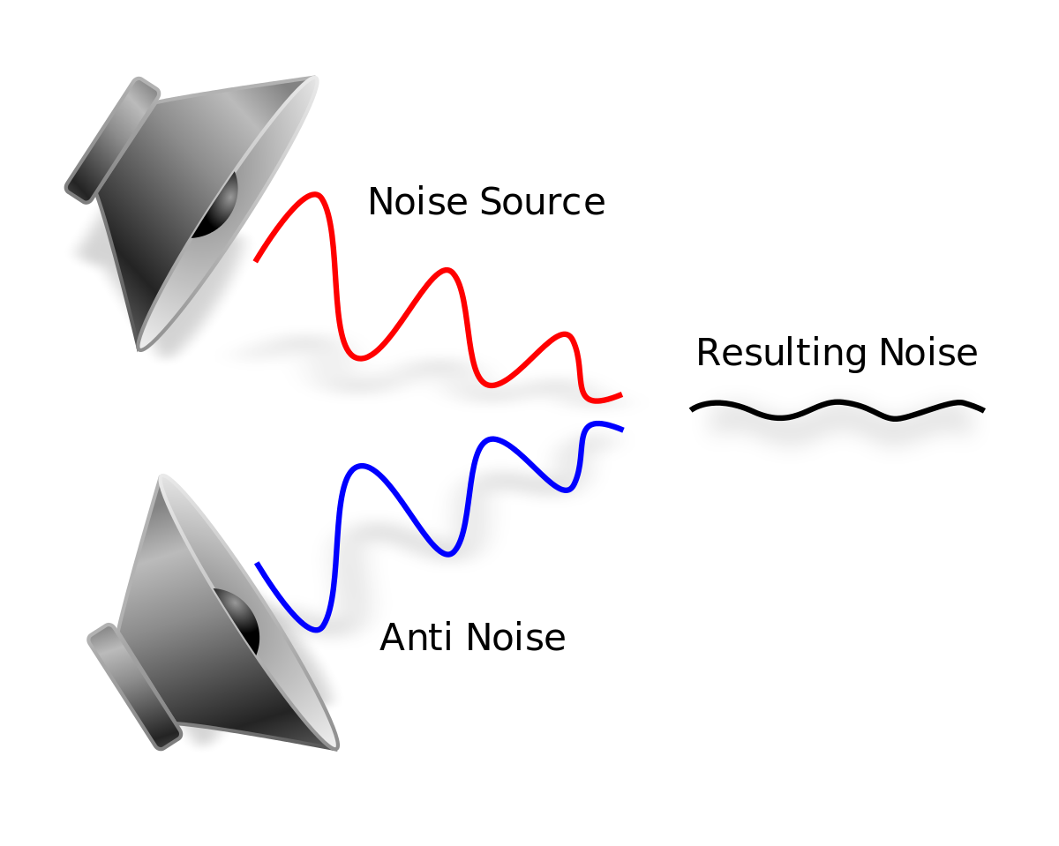
Science behind the idea
Every audio has its own frequency. To cancel an audio frequency, we have to emit wave with the same amplitude but with inverted phase to cancel it out.

Slide 9
Implementation
Placement of microphones in such a way that it can detect every voice nearby.
Train a machine learning model that detects human voice that is most near to it and does not needs to be canceled and detects unwanted audio waves that needs to be canceled out.
Making sure the speaker produces the audio with the same amplitude at the same instant.

Slide 10
Where could it be used?
During an important meeting in a public place
Could be used by schools/educational institutes situated near busy roads.
Could be used at work places near construction sites
Could be used while sleeping to prevent any additional noise that disturbs the user.

Slide 11
Challenges faced as a student to make it possible
Lack of resources
Lack of professionalism
Making sure the process of noise cancelation is instantaneous and the inverted audio is not too loud or too quiet.

Slide 12
Thank You!
By: Keshav Majithia

